Slide 1

Winning Business Proposals
JEEV
Joe Robbins
Ethan John
Enrique Lambrano
Virgil Inferido
Machine Learning for Winning Contracts, Awards, Bids & Grants

Slide 2
U.S. Federal Govt Spending
There is no surprise that the U.S. government spends a lot of money, and for fiscal year 2017, the U.S. federal government committed $507 billion in contracts for goods, services, research and development. That's approximately 13% of the total Fiscal Year 2017 federal budget of $3.98 trillion.

Slide 3

About Us
JEEV Enterprises
JEEV is a global data analytics firm that bids on thousands of projects each year on behalf of governments and businesses.
Uses Machine Learning and AI to better predict and win contracts.
We employ Data Scientists and Statisticians

Slide 4






Motivation
Our core business areas are:
  Criminal Justice
  Health Care
  Education
Key Questions we attempt to answer
We waste millions of dollars each year bidding on losing proposals.
How can we use Machine Learning to make better decisions regarding the use of our resources?
  Energy
  International Development
  Agriculture

Slide 5
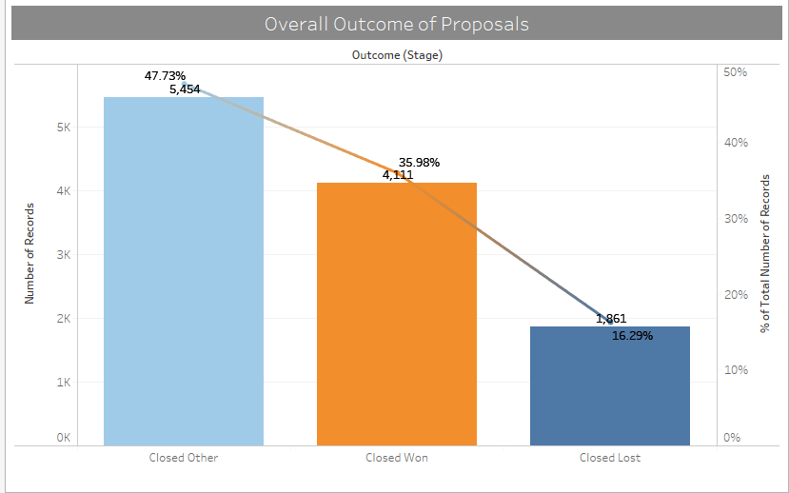
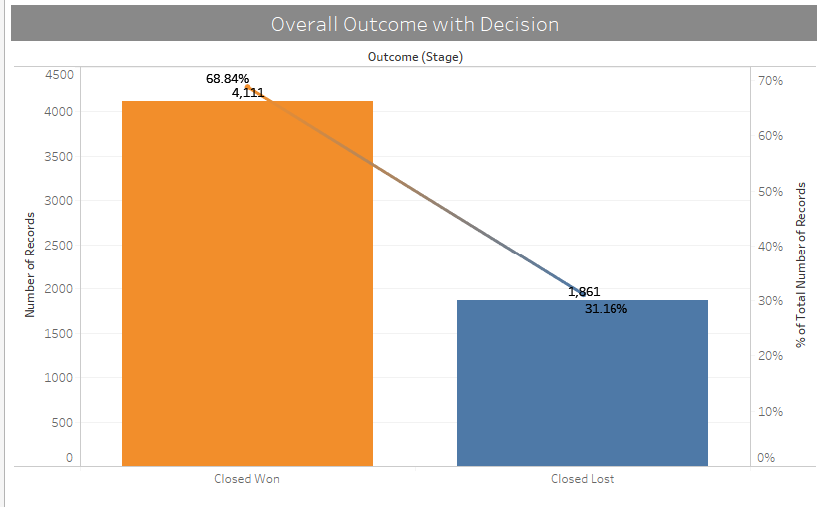
Bidding Results
Categorize the Outcome of bids into three main parts:
  Win, Lose, and Other (Canceled, Didn’t Bid)
Overall Conversion Rate on all Bids
Conversion Rate on Bids with Decision

Slide 6
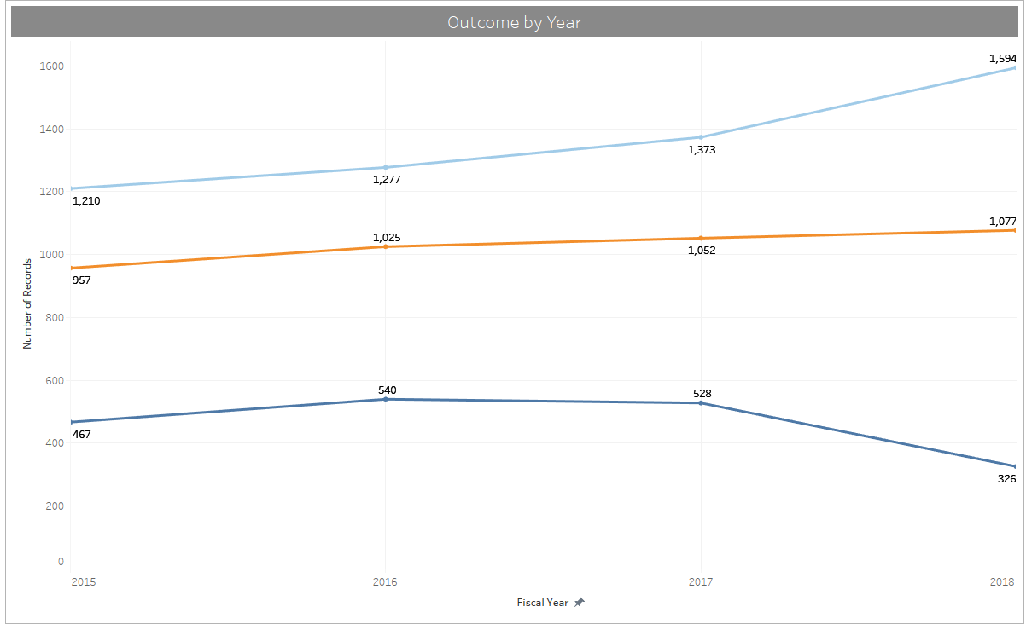
Historical performance has been stagnant
Outcome of Bids Over past 4 Years
Other
Wins
Losses
Increase in Other in 2018 due to impact of Government Shutdown

Slide 7
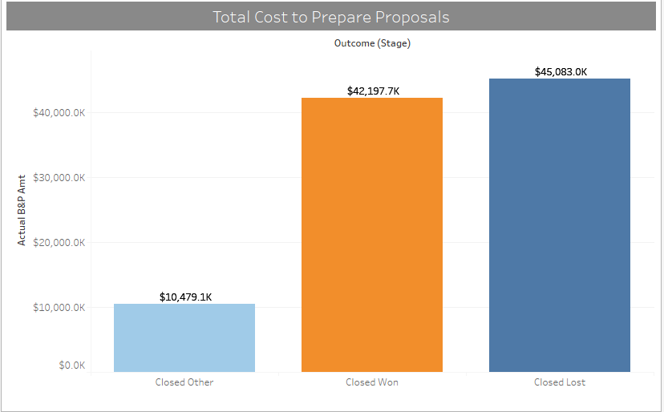
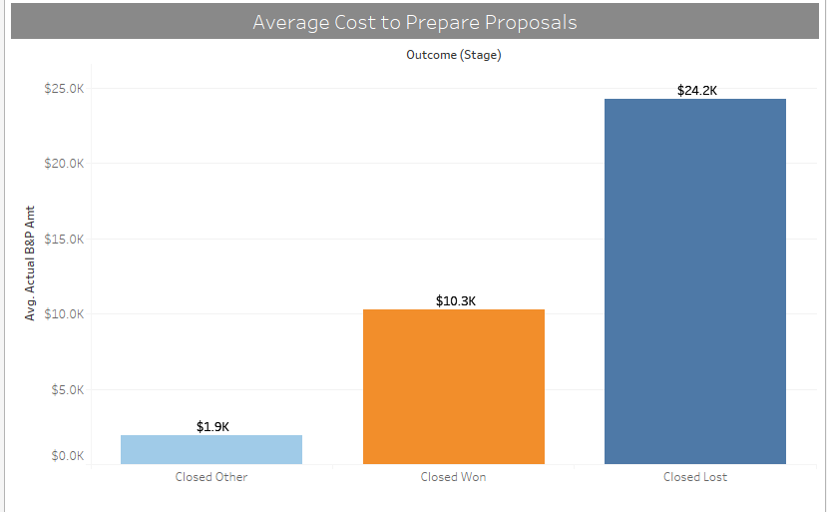
Bidding Costs: Disproportionate amount spent on Lost Bids

Slide 8
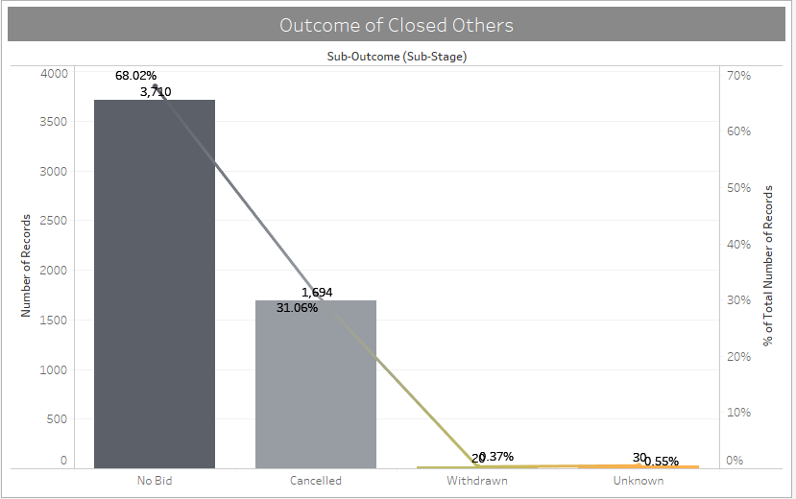
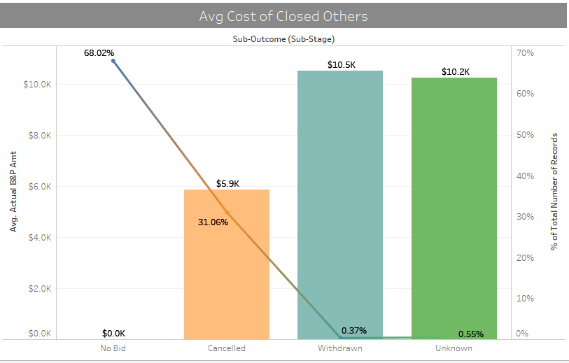
Results of Other Bids

Slide 9
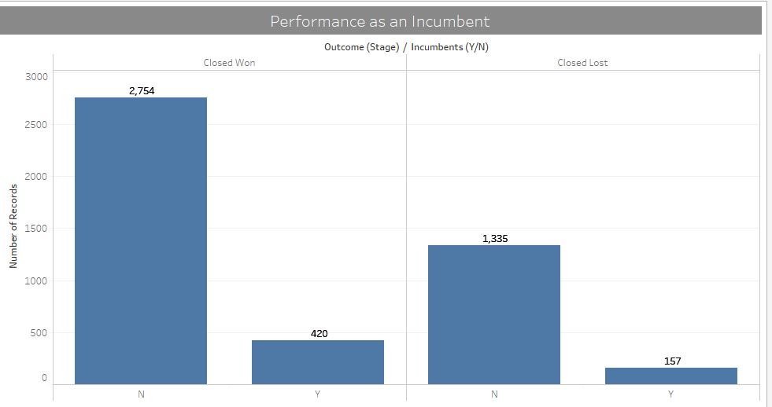
Mythbuster: Not winning as well as we thought as an incumbent
Win % as Incumbent: 72%
Win % as Not an Incumbent: 68%

Slide 10
Data Variables
Primary data source is from our CRM that captures all opportunities that could result in a bid or not
Fields used in our model (Highlighted fields that were significant variables in the models):
CRM Fields
Opportunity ID | Incumbents (Y/N)
Proposal # | Add-On Project (Y/N)
Fiscal Year | Task Order under Existing SOW (Y/N)
Outcome (Stage) | JEEV Prime (Y/N)
Outcome (Sub-Stage) | Subcontractors (Y/N)
Bid Recommendation/Bid Status | Contract Type
PDO Solicitation Received Date | Contract Type Category
Close Date | Estimated Fee (%)
Business Unit | Amount
Unit | Estimated JEEV Amt
Division | Total Proposed Base + Option: Total Price
Probability of Winning (%) | Estimated B&P Amt
Customer Name | Actual B&P Amt
Customer Category 2 | Estimated Subcontractor Amt
Funding Source Name | Last Submission Date
Funding Source Category 2 | Estimated Start Date
Competitive (Y/N) | Estimated End Date
JEEV is Incumbent (Y/N) | Estimated Base Duration (Months)

Slide 11
Data Cleaning: Its not a model without some cleaning

Slide 12
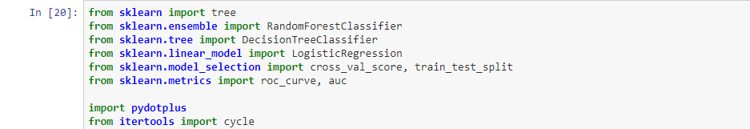
Background on Model
Purpose of Model is to determine key factors in winning bids
The “Y” being a 1 or 0 a winning bid
Naturally we decided to use the below:
  Logistic Regression
  Decision Tree
  Random Forest
Tools: Python, Jupyter Notebook, SciKit-Learn, Tableau
Libraries applied:

Slide 13
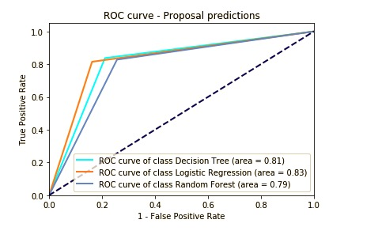
Overall Result
All three models combined had 79.9%
  Logistic Regression was the highest with .83 Positive Rate
  Decision Tree had .81 Positive Rate
  Random Forrest was last at .79 Positive Rate
But was Logistic Regression Really the Best Model?

Slide 14
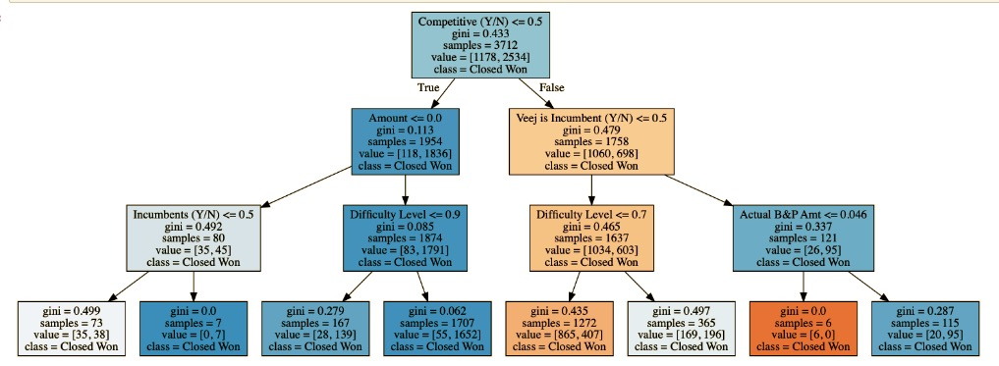
Decision Tree: Didn’t Provide the results we wanted
Based on a Winning Bid
Darker blue better the probability
Gini best case is 0, worst case is 1
* Are subjective metrics
*
*
*

Slide 15
Logistic Regression Parameters
Difficulty Level = 0.327983 x Difficulty Level
Amount = 1/(-4.13 E^10 x Amount)
Bid Cost (B&P Amount) = 1/(1.45 e^6 x Bid Cost)
Competitive = -2.12 x 1 For Yes or 0 for No
JEEV Incumbent = 1.858351 x 1 For Yes or 0 for No
Incumbent = .037 x 1 For Yes or 0 for No
Add-On = 1.54 x 1 For Yes or 0 for No
Task Under Existing SOW = 0.45 x 1 For Yes or 0 for No
JEEV is Primary (Vendor) = .41 x 1 For Yes or 0 for No
Subcontractor = .098 x 1 For Yes or 0 for No
X Intercept=.2709

Slide 16
Results of when plotting the values according to the model
Range | Total Count | % od Total
.1 to less than less than.2 | 136 | 3%
.2 to less than less than.3 | 654 | 14%
.3 to less than less than.4 | 677 | 15%
.4 to less than less than.5 | 401 | 9%
.5 to less than less than.6 | 140 | 3%
.6 to less than less than.7 | 52 | 1%
.7 to less than less than.8 | 142 | 3%
.8 to less than less than.9 | 518 | 11%
.9 or higher | 1921 | 41%
Range | Total Count | % od Total
.1 to less than less than.2 | 30 | 1%
.2 to less than less than.3 | 187 | 6%
.3 to less than less than.4 | 228 | 7%
.4 to less than less than.5 | 187 | 6%
.5 to less than less than.6 | 78 | 2%
.6 to less than less than.7 | 41 | 1%
.7 to less than less than.8 | 142 | 3%
.8 to less than less than.9 | 448 | 14%
.9 or higher | 1,851 | 59%

Slide 17
Post Mortem
Thorough review of the data
Just cause you are an incumbent it doesn’t mean the business is yours
Always need to make a reality check on the model
The more models are sometimes merrier

Slide 18
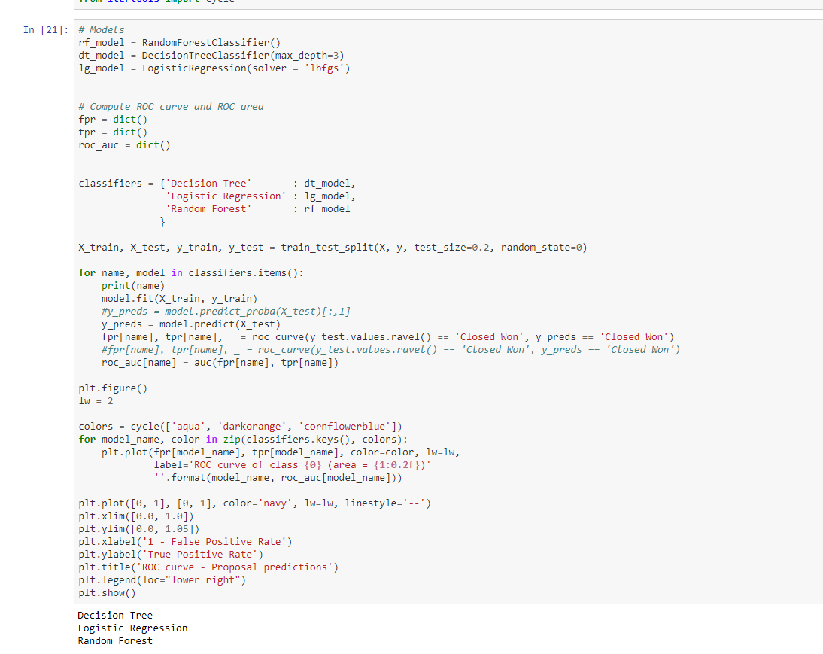
Code Example

Slide 19
Questions?
JEEV
Data Science

